Slide 1


New Student Orientation
Master of Public Administration (MPA) Program
August 17, 2024 | Gordon Hall 339

Slide 2

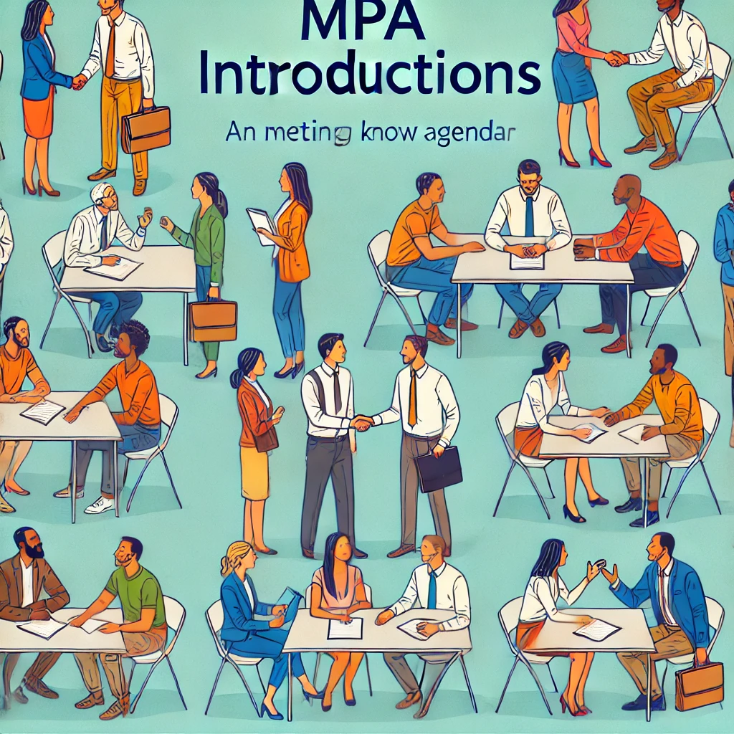



MPA Orientation Agenda
Welcome
Introductions
About the Program
Breakout Groups
Wrap Up
Start the day with a warm welcome and an overview of what’s ahead.
Meet your peers and faculty to start building connections.
Discover the key details of the MPA program.
New students meet with the program director to discuss program expectations.
Guests meet with faculty and recent alumni
Review the day’s key points and clarify any final questions. Network with peers.

Slide 3
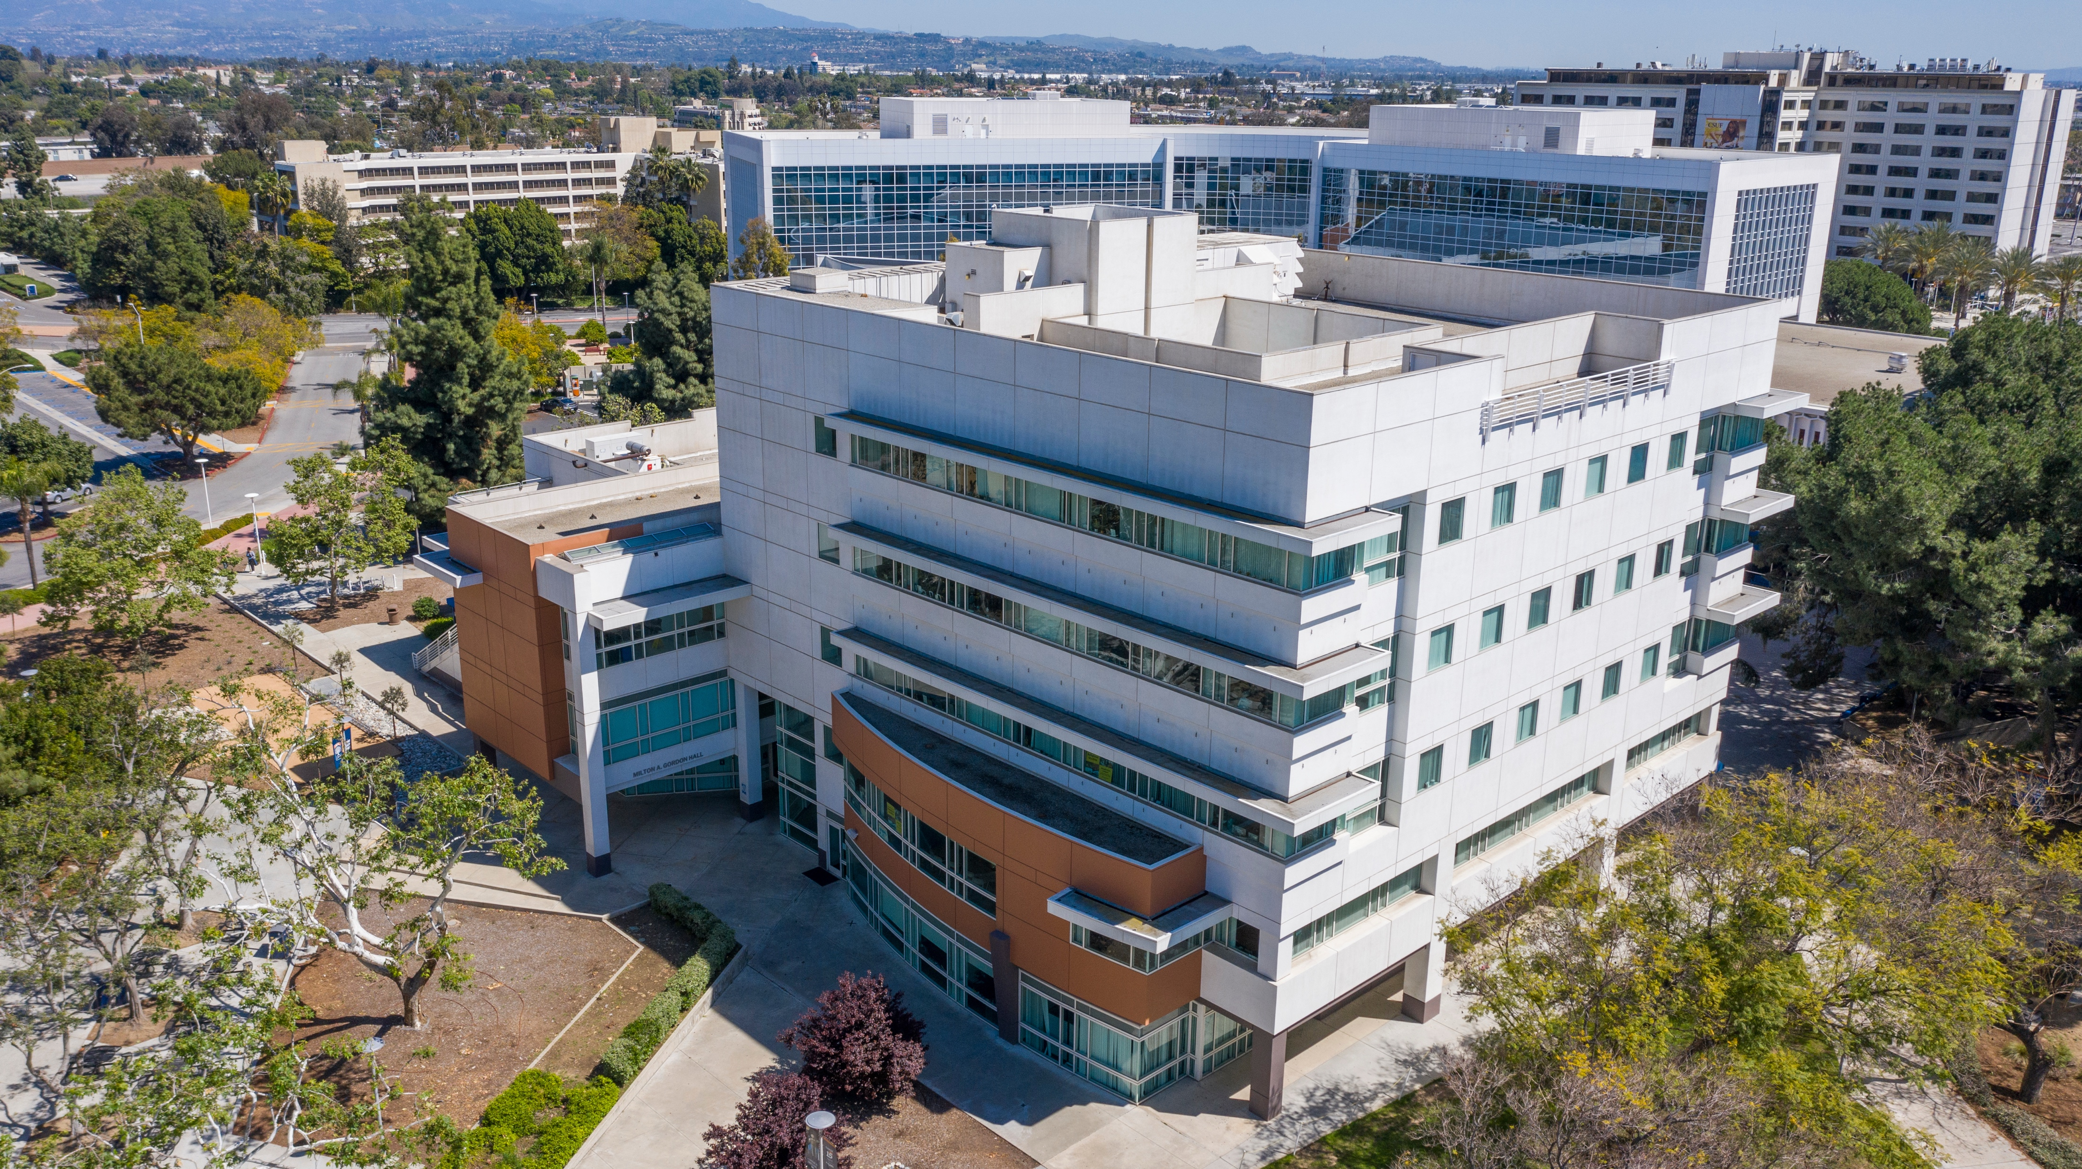

Slide 4

Introduce Yourselves
Faculty
New Students
Alumni

Slide 5
CSUF MPA Program by the Numbers
Awarding degrees since 1968
The only public MPA in OC
93 Students in the Program
~30 Graduates each Year
Four Concentrations
Three years is typical to complete the program

Slide 6
The Value of a CSUF MPA
#1: We are the most selective public MPA program in Southern California
13.3: We have the lowest student-to-faculty ratio of any public MPA program in Southern California
1,100: Alumni in our network serving in all levels of government and the nonprofit and private sectors
1980s: Continuously accredited by the Network of Schools of Public Policy, Affairs and Administration (NASPAA)

Slide 7
Value of a CSUF MPA
Our student to faculty ratio is 10.3—the lowest of any public MPA program in Southern California
1,200+ Alumni in our network serving in all levels of government, as well as nonprofit and private sectors
We are the most selective public MPA program in Southern California
Continuously accredited by the Network of Schools of Public Policy, Affairs, and Administration (NASPAA) since 1983

Slide 8
Distinguished Alumni in Local Government
City Managers (current and former)
Other Local Government (Current and Former)
Anaheim
Costa Mesa
Garden Grove
Fullerton
Irvine
Jurupa Valley
La Mirada
La Habra
Lake Forest
Orange
San Juan Capistrano
South Pasadena
Stanton
Tustin
Walnut
Whittier
Assistant City Manager, Newport Beach
Assistant City Manager, Huntington Beach
Chief HR Officer, Orange County
Chief Operating Officer, Orange County Power Authority
Assistant City Manager, La Mesa
Director of Strategy, Detroit, MI
Elected Director, Santa Margarita Water District
Assistant City Manager, Port Hueneme
Senior Management Analyst, San Juan Capistrano
Assistant City Manager, Novato
Supervisor, Brea Family Resource Center

Slide 9
Distinguished Alumni (Federal, State, Nonprofit, Private)
Bruce G. Lawson (1972): Managing Director of Fox Lawson Associates, a Division of Gallagher Benefit Services, Inc.
Melissa Riordan (1998): Executive Director, Alumni & Community Relations at Cal Poly Pomona.
Jennifer Whyte (2008): Colorado Bureau of Land Management as Lead Realty Specialist/Renewable Energy Program Manager.
James Hodgson (2012): Industrial Operations Analyst for the US General Services Administration.
Samantha Marin Rivera (2013): Equal Opportunity Specialist for the USDA in the Animal Plant Health Inspection Services, Office of Civil Rights, Diversity and Inclusion.
Seon Chun-Burbank (2014): Chair of Early Childhood Education programs at Vanguard University of Southern California.
Claudia Keller (2017): Chief Mission Officer, Second Harvest Food Bank

Slide 10
Our Mission
To prepare our students for a career in public service by providing a core set of competencies anchored in the foundations of scholarly research and professional practice. Our students develop knowledge, skills, and public service values that equip them to be ethical and exceptional leaders in their communities who act with a commitment to public service, democratic values, accountability, social equity, and diversity.

Slide 11
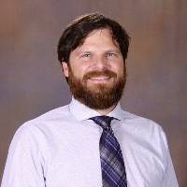
David P. Adams, Ph.D.
Associate Professor and MPA Director
At CSUF since 2016
Ph.D. in Public Policy and Public Administration from Auburn University
Research: Policy Outcomes, Performance, Administrative Discretion, Collaborative Governance, Community Resilience
MPA Courses
POSC 509 Foundations of Public Administration
POSC 521 Capstone Seminar: Public Administration Theory
POSC 588 Collaborative Governance

Slide 12
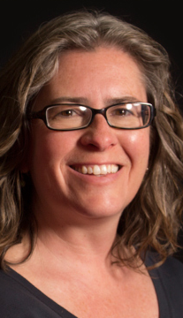
Shelly Arsneault, Ph.D.
Professor
At CSUF since 2002
Ph.D. in Political Science from Michigan State University
Editorial Board, Journal of Public Affairs Education
Research: Nonprofit Management, Education Policy
MPA Courses
POSC 509 Foundations of Public Administration
POSC 521 Seminar in Public Administration Theory
POSC 526 Public Organizational Theory & Behavior
POSC 539 Seminar in Nonprofit Sector Management

Slide 13
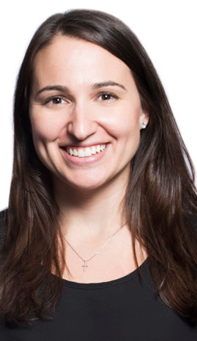
Meriem Doucette, Ph.D.
Associate Professor
At CSUF since 2015
Ph.D. in Public Administration and Policy from the University of Georgia’s School of Public and International Affairs
Admissions Coordinator
Research: Organizational Theory and Change, Feedback
MPA Courses
POSC 526 Public Organizational Theory & Behavior
POSC 446 Corruption, Ethics and Public Policy
POSC 475 Administrative Law
POSC 582 Organizational Development and Change

Slide 14
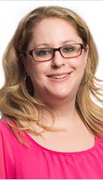
Sarah A. Hill, Ph.D .
Professor
At CSUF since 2007
Ph.D. in Social Science from the California Institute of Technology
Research: Education Policy, Elections Administration
MPA Courses
POSC 426 Education Politics and Policy
POSC 519 State and Local Government
POSC 528 Seminar in Public Policy
POSC 423 Diversity in Public Management

Slide 15
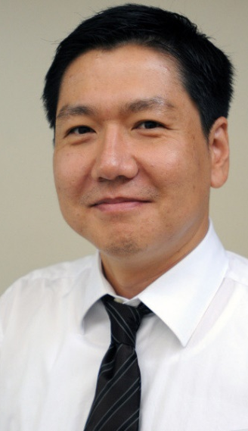
Myung-Jung “MJ” Kwon, Ph.D.
Professor
At CSUF since 2009
Ph.D. in Public Administration and Policy from Florida State University’s Askew School of Public Administration and Policy
Research: Telework, Sustainability, Strategic Planning
MPA Courses
POSC 572 Human Resources Management for Public Organizations
POSC 522 Seminar in Public Personnel Administration
POSC 423 Diversity in Public Management

Slide 16
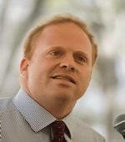
Scott Spitzer, Ph.D.
Professor
At CSUF since 2006
Ph.D. in Political Science from Columbia University
Research: Urban politics, racial politics, social welfare policy, presidential leadership
MPA Courses
POSC 427 Metropolitan Politics and Policymaking
POSC 459 Social Welfare Politics and Policy

Slide 17
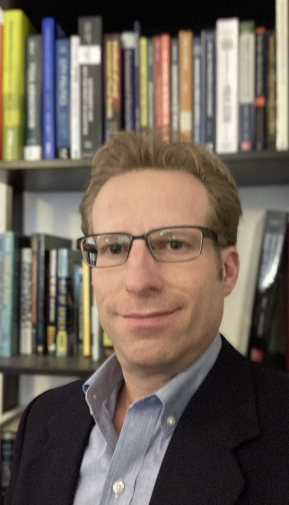
Samuel B. Stone, Ph.D.
Professor
At CSUF since 2011
Ph.D. in Public Affairs from Indiana University’s O’Neill School of Public & Environmental Affairs
Research Areas: Financial Condition Analysis, Fines, Fiscal Decentralization
MPA Courses
POSC 525 Local Government Management
POSC 571 Public Budgeting and Finance
POSC 583 Public Budgeting and Finance II

Slide 18
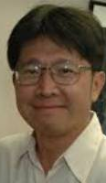
Yuan Ting, Ph.D.
Professor
At CSUF since 1991
Ph.D. in Political Science from Northern Illinois University
Research: Performance Assessment, Job Satisfaction
MPA Courses
POSC 523 Administrative Research and Analysis
POSC 526 Public Organizational Theory & Behavior
POSC 572 Human Resources Management for Public Organizations
POSC 522 Seminar in Public Personnel Administration

Slide 19
Campus Resources and Support
Career Center (Langsdorf Hall 208)
http://www.fullerton.edu/career/
Children’s Center
https://asi.fullerton.edu/childrens-center
Student Wellness
http://www.fullerton.edu/studentwellness/
Disability Support Services
http://www.fullerton.edu/DSS/
Graduate Studies (McCarthy Hall 112)
http://www.fullerton.edu/graduate/
Graduate Student Success Center (Pollak Library South, Room 365)
http://www.fullerton.edu/graduate/gssc/
Parking and Transportation Services
http://parking.fullerton.edu/
Pollak Library
http://www.library.fullerton.edu/
SOAR Graduate Student Services
http://www.fullerton.edu/graduate/soar/soar_services.php

Slide 20
Campus Resources and Support
Titan Dreamers Resource Center
http://www.fullerton.edu/tdrc/
Titan Shops
http://www.titanbookstore.com/home.aspx
TitanCard (Pollak Library 1st Floor – South Wing)
http://www.fullerton.edu/IT/services/TitanCard/
Tuffy’s Basic Needs Services
http://www.fullerton.edu/deanofstudents/tuffys_basic_needs/index.php
Veterans Resource Center
http://www.fullerton.edu/veterans/
WoMen’s Center
http://www.fullerton.edu/womenscenter/
Computer Labs
http://www.fullerton.edu/STS/computer_labs/
Career Center (Langsdorf Hall 208)
http://www.fullerton.edu/career/
Office of Financial Aid (Gordon Hall 146)
http://www.fullerton.edu/financialaid/

Slide 21
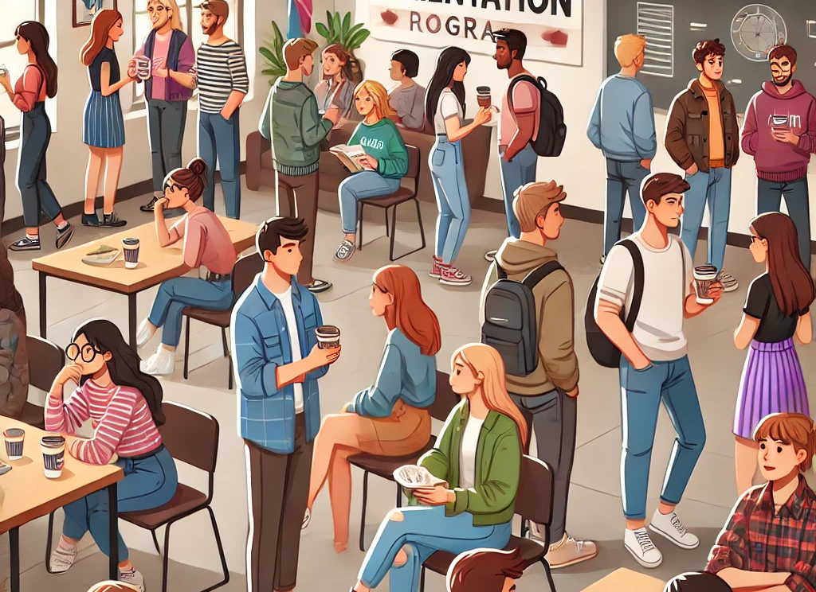
Time for a Break
We’ll start back in about 10 minutes
Guests and Alumni in GH 339
New Students in GH 335

Slide 22
MPA Orientation
Academic Information
August 17, 2024 | Gordon Hall 335

Slide 23
Structure of the Program
Total Units: 36 (12 courses)
Prerequisites
Core courses
Concentration
Electives
Internship (only required for students without public sector experience)
Comprehensive Exam

Slide 24
Prerequisites
American Government or US History (must be completed before you begin program)
Economics
Statistics or Research Methods
Must be completed
By the end of first year
At an accredited college or university
With a grade of “C” or better
When you have completed them, send transcripts to MPAadvising@fullerton.edu

Slide 25
Core Courses
Students must take ALL of the following courses:
POSC 509 Foundations of Public Administration
POSC 523 Administrative Research and Analysis
POSC 526 Public Organizational Theory & Behavior
POSC 571 Public Budgeting and Finance
POSC 572 Human Resources Management for Public Organizations
POSC 521 Capstone Seminar: Public Administration Theory
And at least one of the following:
POSC 519 State and Local Government
POSC 525 Local Government Management
POSC 528 Seminar in Public Policy
For students with no previous public sector managerial working experience, the following course is required:
POSC 497 Internship in Public Administration

Slide 26
Internship
Requirements:
3-unit class with written work requirements
300 hours of internship experience in a public or nonprofit organization
Most students intern in local government.
Students can also earn their internship credit by spending a summer in Washington, D.C. These students often intern with a federal agency or a nonprofit organization.
The internship coordinator (Antonia Castro-Graham) has a long list of placement leads with agencies/alumni who frequently contact the program to invite intern applications.
Our MPA students secure paid internships in about one-third of cases.

Slide 27
Advising
The MPA Director and the MPA Advisor serve as advisors to all MPA students and assist students in
academic program planning
selection of a concentration
application of transfer credits
choice of electives

Slide 28
Concentrations
All students must choose one of the existing concentrations:
Human Resource Management
Local Government Management
Public Finance
Public Policy
Concentrations should be complementary, not supplementary

Slide 29
Concentration in Human Resources
Concentration Core Course:
POSC 572 Human Resources Management for Public Organizations
Concentration Electives (at least two):
POSC 423 Diversity in Public Management
POSC 475 Administrative Law
POSC 522 Seminar in Public Personnel Administration
POSC 582 Organizational Development and Change
MGMT 441 Labor-Management Relations

Slide 30
Concentration in Local Government Management
Concentration Core Course:
POSC 525 Local Government Management
Concentration Course (at least one):
POSC 427 Metropolitan Politics and Policymaking
POSC 519 State and Local Government
Concentration Electives:
POSC 588 Collaborative Governance
ENST 595T Selected Topics in Environmental Problems*
POSC/GEOG 478 Urban Planning Principles
POSC/GEOG 484 Planning Methods

Slide 31
Concentration in Public Finance
Concentration Core Courses (take both):
POSC 571 Public Budgeting and Finance
POSC 583 Public Budgeting and Finance II
Concentration Electives (at least one):
POSC 421 Government & the Economy
POSC 425 Policy Analysis
ECON 416 Benefit Cost and Microeconomic Policy Analysis
ECON 417 Public Finance

Slide 32
Concentration in Public Policy
Concentration Core Courses (take both):
POSC 425 Policy Analysis
POSC 528 Seminar in Public Policy
Concentration Electives (take one):
POSC 421 Government and the Economy
POSC 426 Education Politics and Policy
POSC 427 Metropolitan Politics and Policymaking
POSC 459 Social Welfare Politics and Policy
POSC 539 Seminar in Nonprofit Sector Management
CRJU 405 Criminal Justice Policy
CRJU/POSC 491 Applied Policy Research
ECON 416 Benefit Cost and Microeconomic Policy Analysis
PUBH 524 Public Health Administration

Slide 33
Advisor Approved “General” Electives
POSC 421 Government and the Economy
POSC 423 Diversity in Public Management
POSC 425 Policy Analysis
POSC 426 Education Politics and Policy
POSC 427 Metropolitan Politics and Policymaking
POSC 446 Corruption, Ethics and Public Policy
POSC 459 Social Welfare Politics and Policy
POSC 475 Administrative Law
POSC 519 State and Local Government
POSC 522 Seminar in Public Personnel Administration
POSC 525 Local Government Management
POSC 528 Seminar in Public Policy
POSC 539 Seminar in Nonprofit Sector Management
POSC 580 Emergency Management in Public Administration
POSC 582 Organizational Development and Change
POSC 583 Public Budgeting and Finance II
POSC 588 Collaborative Governance
POSC/GEOG 478 Urban Planning Principles
POSC/GEOG 484 Planning Methods
CRJU 404 Capital Punishment
CRJU 405 Criminal Justice Policy
ECON 416 Benefit Cost and Microeconomic Policy Analysis
ECON 417 Public Finance
ENST 595T Selected Topics in Environmental Problems (only certain sections will count- must get MPA advisor approval in advance)
GEOG 481 Geographic Information Systems: Introduction
GEOG 488 Land Use Analysis
PUBH 524 Public Health Administration
MGMT 441 Labor-Management Relations
MGMT 542 Labor and Employment Relations Seminar

Slide 34
What your program will actually look like*
POSC 509 Foundations of Public Administration
POSC 523 Administrative Research and Analysis
POSC 526 Public Organizational Theory & Behavior
POSC 571 Public Budgeting and Finance
POSC 572 Human Resources Management for Public Organizations
POSC 521 Capstone Seminar: Public Administration Theory
POSC 519 State and Local Government, or POSC 525 Local Government Management, or POSC 528 Seminar in Public Policy
Concentration Core Course/Elective
Concentration Elective
Advisor Approved Elective
Advisor Approved Elective
Advisor Approved Elective
*if you don’t do the internship

Slide 35
Milestones
First Semester:
Take POSC 509 Foundations of Public Administration and up to ONE other course:
POSC 523 Administrative Research and Analysis
POSC 526 Public Organizational Theory & Behavior
POSC 571 Public Budgeting and Finance
POSC 572 Human Resource Management
Second Semester:
Choose concentration
Completion of 18 Units:
Eligible to join Pi Alpha Alpha with a GPA of 3.70 or higher
Third to last Semester:
Complete all of the core courses for the program and concentration
Penultimate Semester (Fall):
Take POSC 521: Seminar in Public Administration Theory.
Prepares students for taking the comprehensive exam
Only offered in the fall
Must be in your final year to enroll.
Final Semester (Spring):
Comprehensive Exam: Taken over the course of a week in mid-January.
File Grad Check when you take comprehensive exams

Slide 36
How many courses to take per semester
No more than two
Program is 36 units (12 courses)
2 courses/semester x 2 semesters per academic year x 3 years = 12 courses
We typically offer two courses over the summer occasionally one in winter
The program can be completed in 3 years but does not have to be. You may take as long as 5 years. There is no rush!

Slide 37
GPA
Each course on the master’s Study Plan must be completed with a grade of “C” (2.0) or better.
Must maintain minimum overall GPA of 3.0 (“B”) or better
Grades in grad school: what “A”s, “B”s and “C”s mean

Slide 38
Repeated Courses
Different from undergrad:
For master’s degree students, if a grade less than “C” (2.0) is received, the course must be repeated and passed with a grade of “C” (2.0) or better.
A course may be repeated only once.
If a course is repeated, both grades are included when computing the student’s Study Plan and cumulative CSUF grade point average.
Repetition of a course carries no additional unit credit toward the degree

Slide 39
400-Level Courses
Not all 400-level courses count for graduate credit.
All of the 400-level courses in the MPA program do.
The instructor must assign separate additional assignments to graduate students for the course to count.
Make sure your instructor knows that you are a graduate student. This is a mutual responsibility.

Slide 40
Academic Integrity
Academic dishonesty is a serious offense in higher education. It includes such things as cheating, inventing false information or citations, plagiarism, and helping someone else commit an act of academic dishonesty.
Cheating is the act of obtaining or attempting to obtain credit for work by the use of any dishonest, fraudulent, or unauthorized means.
Plagiarism is that act of taking the specific substance of another and offering it as one's own without giving credit to the source. For example, cutting and pasting from a website without quotation marks and a citation of the source, is an act of plagiarism.
Use of AI without express permission or instruction from faculty is an act of academic dishonesty.
Proper Citations: each faculty member may have slightly different requirements. Read the MPA Writing Guide

Slide 41
Leaves of Absence
A LOA may be granted to conditionally classified or classified graduate students who have completed at least 6 units while in residence at this university toward the degree.
Grounds for requesting a leave of absence include:
Illness or disability (permanent or temporary) or similar personal exigencies including pregnancy that makes it impossible or inadvisable for a student to register for classes.
Activities which enhance a student’s professional career objectives.
Active duty in the armed forces of the United States.
Severe financial hardship.
Other reasons at the discretion of the Associate Vice President for Academic Programs.

Slide 42
Checklist for Starting the First Semester
Register for POSC 509 Foundations of Public Administration and up to ONE other course:
POSC 523 Administrative Research and Analysis
POSC 526 Public Organizational Theory & Behavior
POSC 571 Public Budgeting and Finance
POSC 572 Human Resource Management
Check your CSUF email account regularly
Accept invitation to Canvas MPA Program course
Read the MPA Writing Guide
Get your Titan Card
Complete the TDA tutorial: https://www.fullerton.edu/ittraining/peoplesoft/student/tutorials/TDA/

Slide 43

Questions & Answers?
?

Slide 44
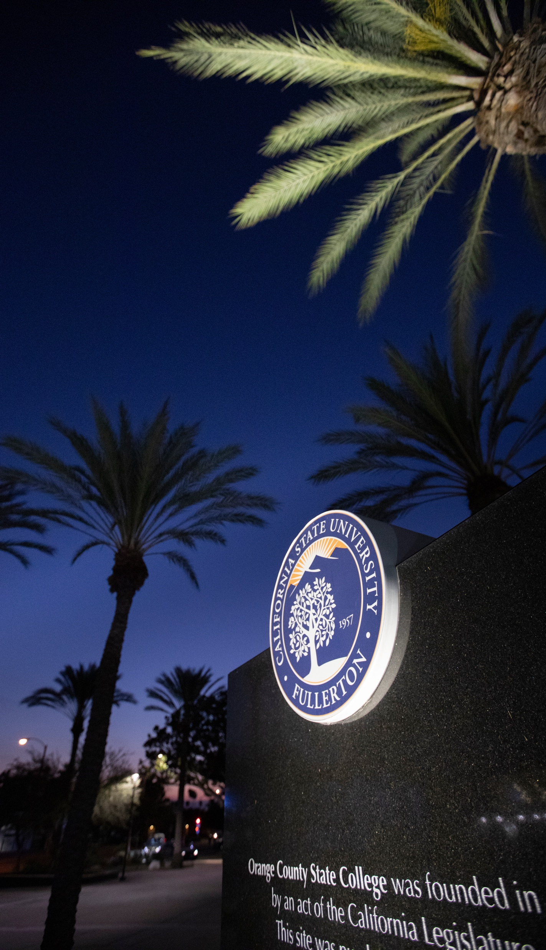
Contact Information
Division of Politics, Administration & Justice
pajdiv@fullerton.edu
mpa.fullerton.edu
657-278-3521
David Adams – MPA Director
dpadams@fullerton.edu
dadams.io/appointments
657-278-4770

Slide 45
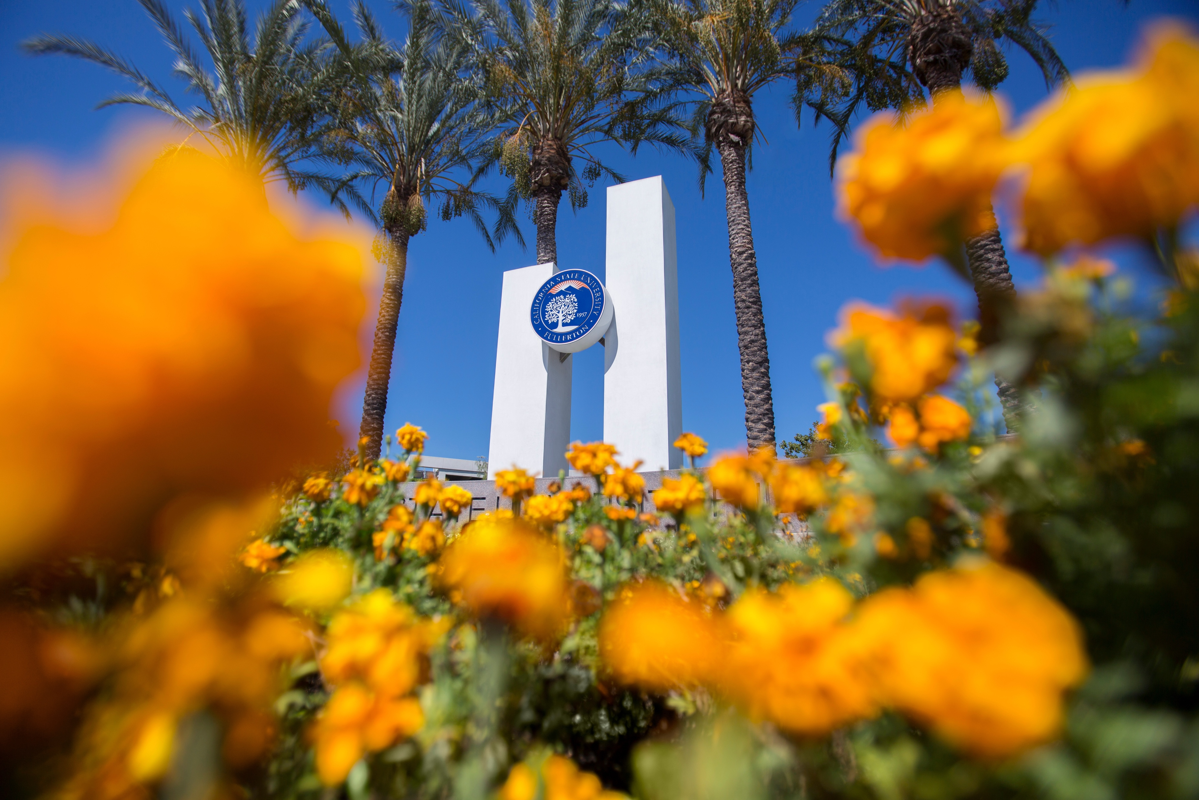
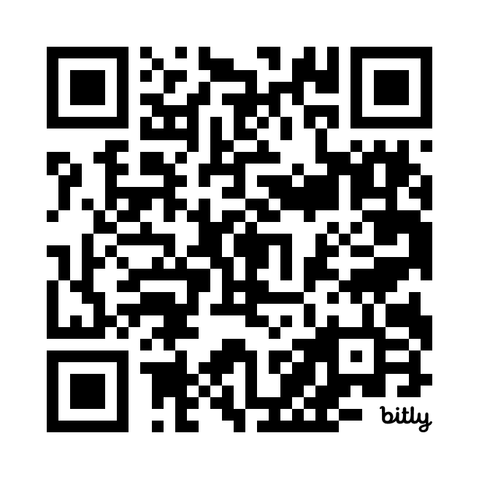
Download this Presentation
https://bit.ly/csufmpa24

